Slide 1

IN A WORLD WITHOUT WALLS AND FENCES,
WE DON'T NEED WINDOWS & GATES.

Slide 2
Free & Open Source Software
Presented By
Amit Dhuri
Shreejit Nair
Abhijit Navale
Bhushan Gaikar
Under The Guidance of
Prof. Ankita Singh

Slide 3
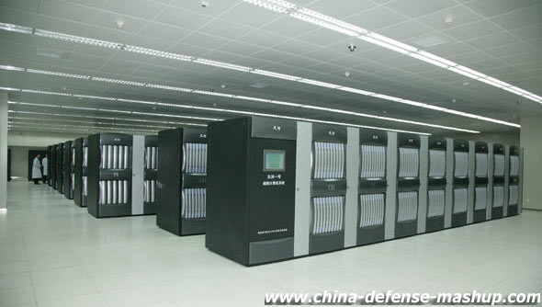
Tianhe-1A
World's Fastest Supercomputer
http://en.wikipedia.org/wiki/Tianhe-I
Computing Rate = 2.507 petaFLOPS

Slide 4
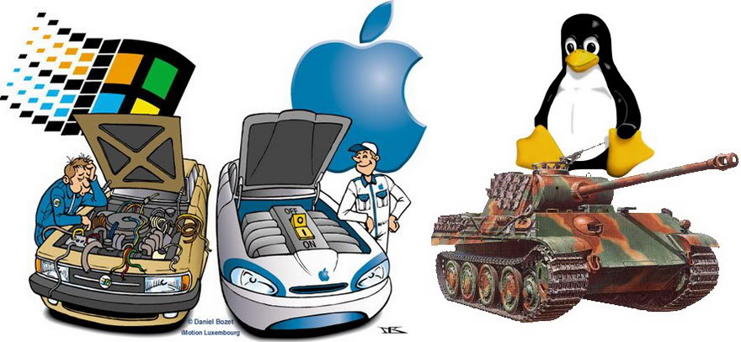
DISCLAIMER
NO COMPARISON
All the images, logos and trademarks are properties of their respective owner.

Slide 5
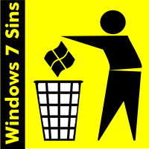

Background
Closed Source/Propriatary
Open Source/FOSS
What is Propriatary Software?
Effect of Propriatary Software
Solution – FOSS!!!
http://en.windows7sins.org/

Slide 6



What is FOSS?
Free & Open Source Software
Free Software Foundation - FSF
GNU Foundation – GNU is Not Unix – Richard Stallman
FOSS – 1. Free 2. Open Source
What is Open Source?
  Legal right to view the source code
http://www.fsf.org/

Slide 7


Free = Freedom
Four Freedoms to computer user:
  The freedom to run the program, for any purpose (freedom 0).
  The freedom to study how the program works, and change it to make it do what you wish (freedom 1). Access to the source code is a precondition for this.
  The freedom to redistribute copies so you can help your neighbor (freedom 2).
  The freedom to distribute copies of your modified versions to others (freedom 3). By doing this you can give the whole community a chance to benefit from your changes. Access to the source code is a precondition for this.
http://www.gnu.org/

Slide 8

Why to have the freedom?
What's wrong in closed source?
  Your Computer is not your computer, your computer is 'THEIR' computer!
Freedom To Assure -
  Security
  Standardisation of technology
  Fast adoption of new technology
  Fast bug fix and sucurity holes
  Cost, No Spyware
  Control over technology and your computer!
  Large range of hardware support and architechture
  Independence
  No Monopoly – Business for everyone
  Job for everyone
http://opensource.org/

Slide 9

FOSS in Action
How FOSS works?
  Community
What does devolopers contribute?
Motivation – Why they contribute?
GNU, X11, Linux and Debian

Slide 10






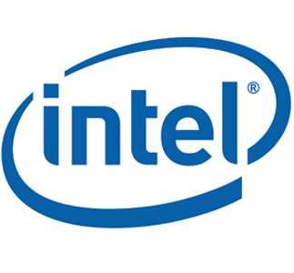





Who Uses FOSS?
RUSSIA
THE INTERNET

Slide 11





Linux
Linux is great application or example of FOSS
What is Linux??
  Foundation of an operating system – A Kernel
  GNU/Linux Operating System
  GNU tools
  GNOME, KDE, LXDE, XFCE or some other DE or window manager
  Package manager – deb, rpm or other
  Culture
  Free of cost or paid
http://www.linux.com/

Slide 12



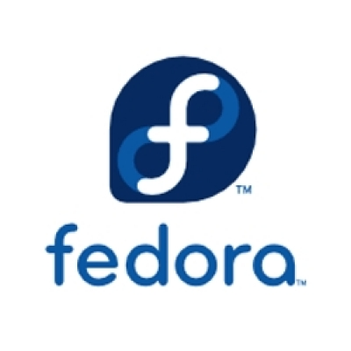



Major Linux distro
There are over 300 distro in market
Which distro to choose ?
  Free/Paid, Culture, Target User, Hardware
Why Ubuntu ?
New user Friendly, lots of help & commercial support
Ubuntu's USP – its community!
www.distrowatch.com

Slide 13
Techical Facts about Linux
Everything is File!
Monolithic Kernel – written in C – Unix-like
No restart No reinstallation, No formatting
Virtual memory, Shared Libraries, preamptive multitasking and multi user
No need to install drivers for mainstream hardwares
GNU General Public License
http://kernel.org/

Slide 14
Get Started
What is UBUNTU?
How To Get Ubuntu?
How to learn using ubuntu?
How to get Help?
  Read Docs - Submit Bugs -Dont Complain
Release Cycle
Full Operating System with security and other updates – free of cost
http://www.ubuntu.com/

Slide 15
How to install ubuntu?
Win/Mac/Linux can reside in peace!
Minimum Requirements
Recommended Requirements
Supported Hardware – Desktop or Laptop
MBR
Partitions
Withing 15-25 minutes it will install
Get updates

Slide 16

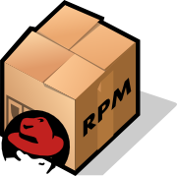

How To get & install softwares?
Software repositories
Applications->Ubuntu Software Center-> find software and click on install! Done!
Traditional way – get from friend or download from web site
Packages - .deb or .rpm or source code
Source Code - .configure, make and make install

Slide 17
Availability of Softwares
Scientific
Programming and development - IDEs
Enterprise
Office
Servers
Databases
Games
Entertainment
Multimedia
Animation
Embedded
http://en.wikipedia.org/wiki/Free_and_open_source_software

Slide 18




Multimedia & Music Store
Need to install codecs
OGG is recommended – Inbuilt support
Support for mp3,mp4,avi,wmv,real player and many restricted formats
Edit, modify and create multimedia – images, audio and videos
Music Store
VLC – the world's well known media player is OPEN
RHYTHMBOX
http://www.omgubuntu.co.uk/

Slide 19
Eye Pleasing Desktop
Compiz, Emerald
Themes, Wallpapers
  Gnome art
  Devianart
  Bisigi
3D Cube
Attractive window tabbing – Shift Switcher
  Super + w, Super + e and Alt + tab, Ctrl Alt -> , Ctrl Alt downarrow
Animations
Woobly Windows
Workspaces
http://www.compiz.org/

Slide 20
Security
Morris’s Three Golden Rules of Computer Security
Linux is far more secure than windows – No virus
It needs a sufficiently dumb user to crack linux machine or social engineer it
Get regular updates – follow the standard security measures
Linux or Unix is preffered on servers for security
http://www.linuxsecurity.com/

Slide 21

How it can be free?
Why they give it free?
  Is this some kind of marketing gimick?
Built by community, for community
They are free of cost
You may get commercial support.
If its free then why to charge for cd, pen drive or support?

Slide 22

Contribute
Why Should you contribute?
You DO NOT need to be an expert to be able to contribute
  Anyone with computer and internet connection can contribute
How to Contribute?

Slide 23

Misconceptions
The Mighty Terminal / Console
Reality – it gives the power to user
Man <command> will tell you everything

Slide 24
Misconceptions (continued)
Hard to use or Hard to learn
No GUI
No Application Softwares
My favorite application dont run on linux!
Linux alternate app is not as powerful as my favorite windows app
No Support
Linux is bad because it don't support .exe file format!
Compatibility with MS softwares
Multimedia
No 3D, high level games
Linux will get virus when it becomes as famous as windows!
FOSS – is not reliable – is not trustworthy – because anyone can create or edit it
It will die soon since no commercial big boy is standing behind linux!
“Linux is not user-friendly. It _is_ user-friendly. It is not ignorant-friendly and idiot-friendly.”

Slide 25
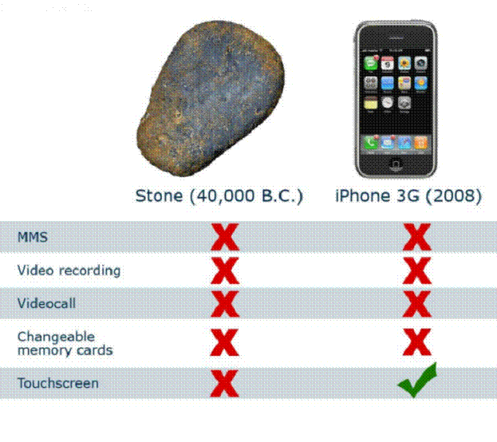
Misconception (continued)
...amm? Innovation?
PRODUCT BACKED UP BY A BIG COMMERCIAL AND EVIL COMPANY DOESNT ASSURE INNOVATION

Slide 26
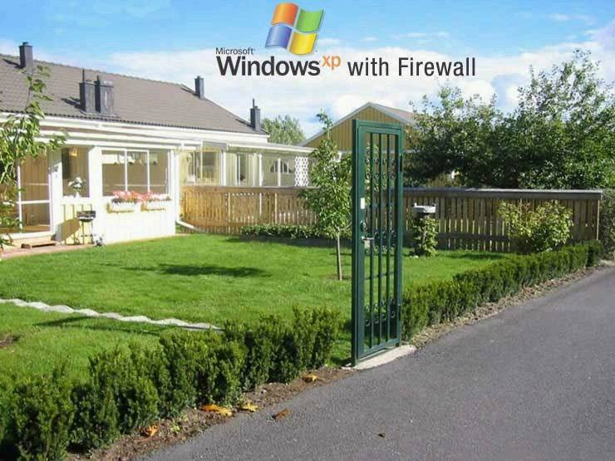
Misconception (continued)
Security? What Security?

Slide 27

Commercial POV
Jobs
  Your resume – get high paying job
  Experience! - forums
Businesses
  Cost! - Easy to maintain- Secure
  Support
  Training
  Enterpise solutions
  Database / Cloud Computing
  Maintenance
  Security Services
  Installation and deployment
  Application development, solutions and consultancy
And many more...

Slide 28






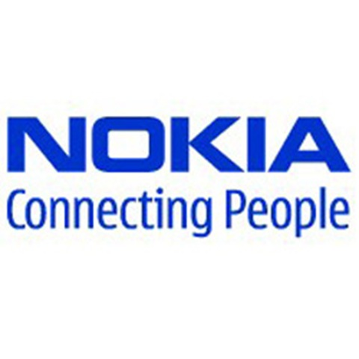



Bussiness in FOSS
Red Hat
Mandriva, Mepis, EyeOS, Xandros, Suse
Google – Android, Chrome OS
Nokia & Intel – Meego, Mobile Phones
Canonical
IBM
Oracle
SGI
HP & Many more...

Slide 29







Derivatives of Ubuntu
Official - supported by Canonical
  Kubuntu
  Xubuntu
  Edubuntu
  Ubuntu Studio
Unofficial – supported by community
  Mythbuntu
  LinuxMCE
  Lubuntu
  Linux Mint
  Backtrack
  Puppy Linux
  And dozens of other

Slide 30




Advantages
The Freedom!
Security – No viruses
Fast bug fixes
Vast majority of architecuture
Innovation, Control over technology
Cost
Easy to learn, use, install and deploy
Availability of softwares
Plug n play – no need for drivers
Embedded Linux – Washing M/C, Car, Refrigerator, AC, TV, Microcontrollers
Human Knowledge Belongs To The World!

Slide 31


Disadvantages
Sooo many choices – very confusing for new user – over 300 distors, approx 10 DE etc.
Open code is of no use without active community
Selfish
No coperation from vendors
Not yet ready for hard core gamers
Not for printing world – CMYK
Cannot be used on monopolistic hardwares
Broadband Internet Connection – for system updates and updated softwares

Slide 32

Conclusion
Clear your mind before trying linux
Linux is Not Windows
  http://linux.oneandoneis2.org/LNW.htm
Linux is not for everyone
Linux started out “By geeks, for geeks.”
Try to understand differences
FOSS is Natural, Democratic – FOSS is Future!
We all, together as a one community
Control the technology and your computer!
It's not just about "Why should I want Linux?", It's also about "Why should Linux want me?"

Slide 33

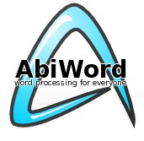


Attribution
LibreOffice Impress
Ubuntu GNU/Linux OS
Ubuntu Font
Report – Abiword
This presentation & report is licensed under a Creative Commons Attribution-NonCommercial-ShareAlike 2.5 India License.

Slide 34

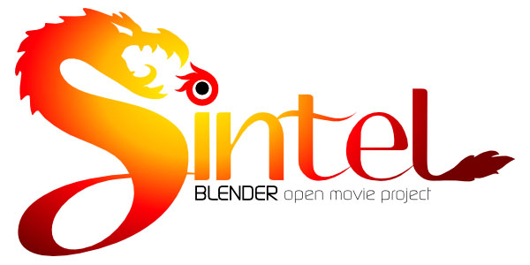
Blender – Alternate for Maya - Open source, 3D, high level, powerful animation suit – free of cost – can built on it
Sintel – 4th movie - To show the power of blender - FOSS
Sound track, images, story, screen play and video – everything is in public domain
14 Minutes duration

Slide 35
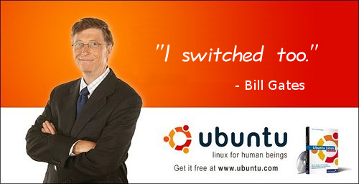
Any Questions?

Slide 36
May The Source Be With You!

